Slide 1

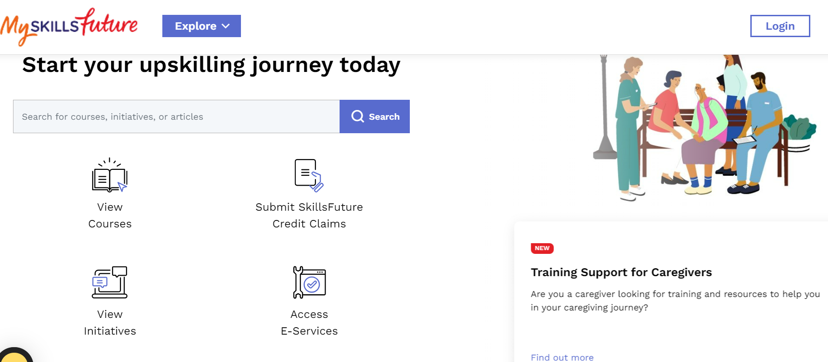
Step 1. Log in using your Singpass
Step 2. Select Access E-Service

Slide 2
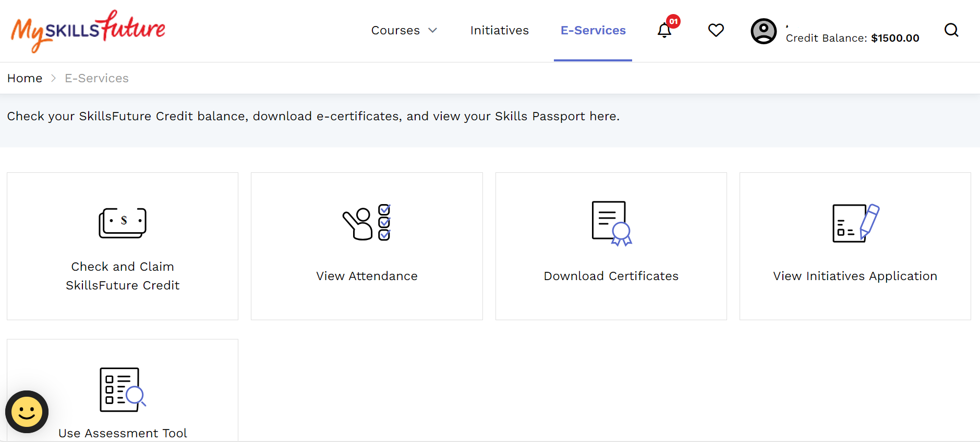
Step 3. Select Check and Claim SkillsFuture Credit

Slide 3
Step 4. Select: Submit A Claim

Slide 4
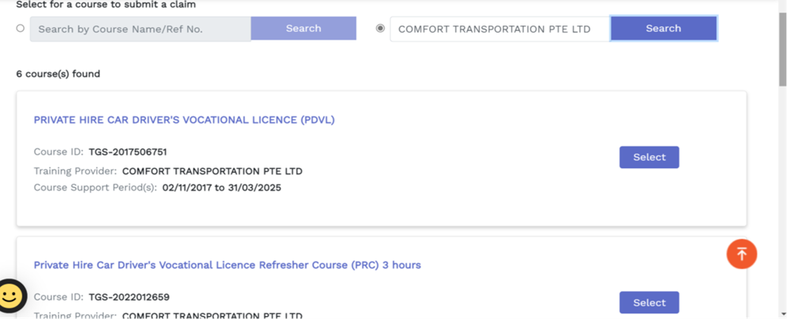
Step 5. Click and Enter “Comfort Transportation Pte Ltd and SEARCH for the course.
For Bus course, enter “ ComfortDelGro Bus Pte Ltd
Step 6. Choose the correct course

Slide 5
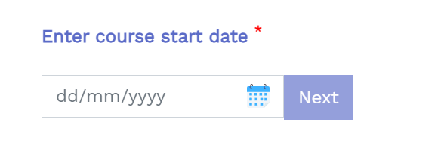
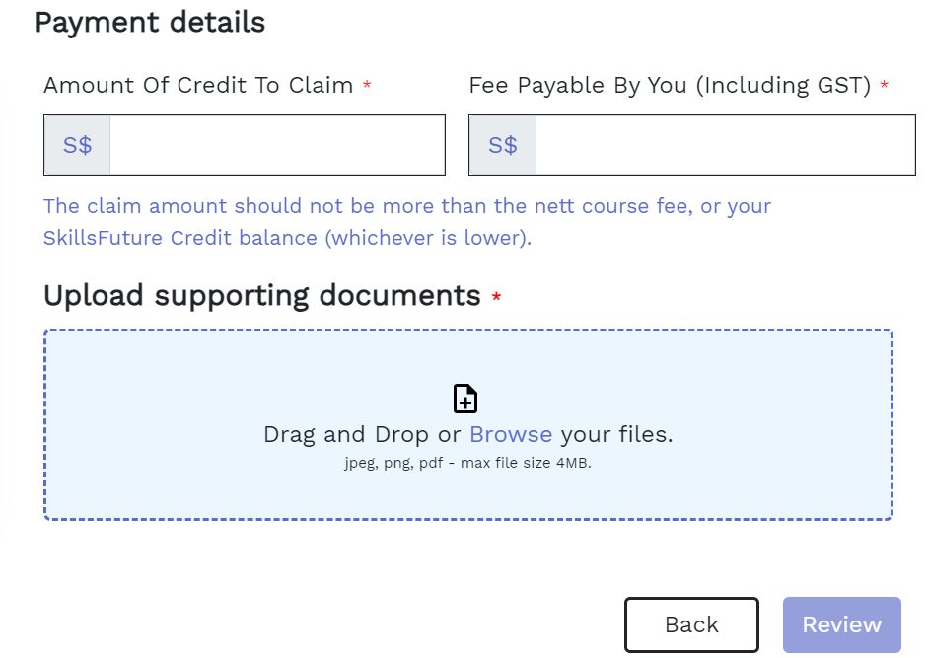
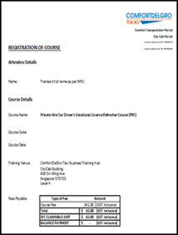
Step 7. Enter the first Day of Course Date
Step 8. Click NEXT
Step 9. Enter both same amount
Step 10. Upload the Registration of Course Letter
Step 11. Click on Review

Slide 6
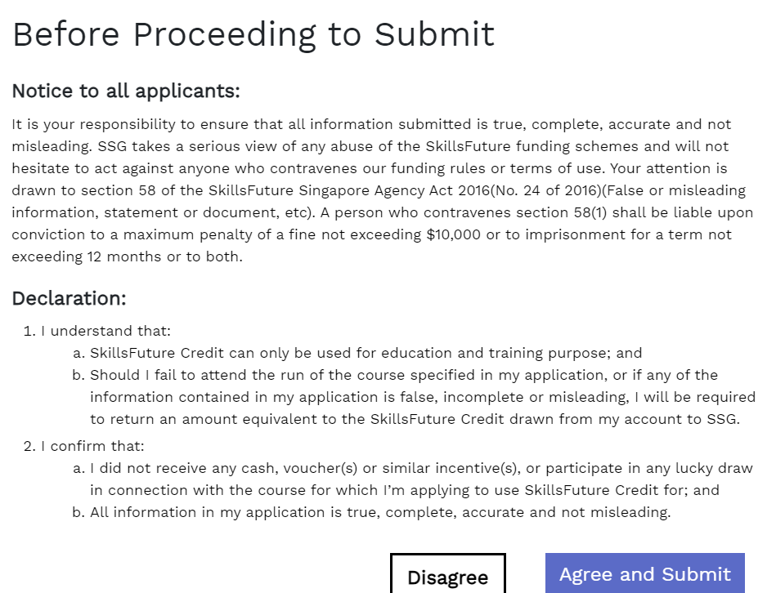
Step 12. Trick and Enter Submit
Step 13. Click on Agree and Submit

Slide 7
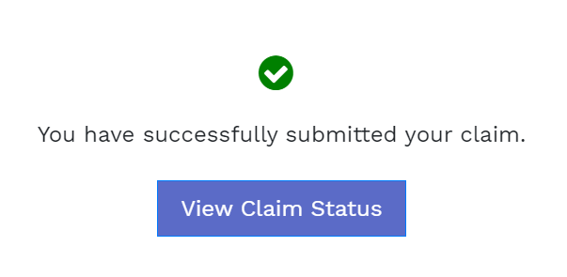
Step 14. Click to View your claim
Final Step. Check the claim details and wait for Approval
The End

